Slide 1

EDA
Exploratory Data Analysis (EDA)
for
Real Estate Pricing
BY-Dharmendra Kumar

Slide 2
Exploratory Data Analysis (EDA) for Real Estate Pricing: Unveiling the Dynamics of House Valuation in a Dynamic Market
Problem Statement:
In the dynamic landscape of the residential real estate market, determining an optimal and competitive price for a house is a multifaceted challenge. As a key member of the analytics team in a leading real estate company, our task is to conduct a comprehensive analysis to identify and understand the myriad variables that significantly influence house prices. By leveraging advanced data analytics techniques and visualization tools, our goal is to uncover patterns, correlations, and trends within the dataset, enabling the company to make informed decisions and strategically position properties for better business opportunities.

Slide 3
Introduction
The purpose of this analysis is to explore the real estate dataset to extract key insights using Python.
The notebook contains Python code and outputs related to the Exploratory Data Analysis (EDA) for a real estate dataset. Here's a brief overview of the initial content:
Data Loading and Libraries:
The notebook begins with importing necessary libraries such as pandas, numpy, matplotlib, and seaborn for data manipulation and visualization.
It loads the real estate dataset (housing_data.csv) from a specific directory.
Initial Data Exploration:
The dataset is displayed to understand its structure, including features like MSSubClass, MSZoning, LotFrontage, LotArea, Street, etc.

Slide 4
Setting Up the Environment
Data exploration:
df1=pd.read_csv(r"D:\project\housing_data.csv")# load first dataset
df1
I complete my project in Google Colab, first i mount my drive with colab.
and after that load first data set.

Slide 5
Setting Up the Environment
Data exploration continue….
load dataset
first 5 rows of housing_data
last 5 rows of housing_data
shape of housing_data
number of rows
number of columns
information of housing_data
Coping the housing_data in house_data

Slide 6
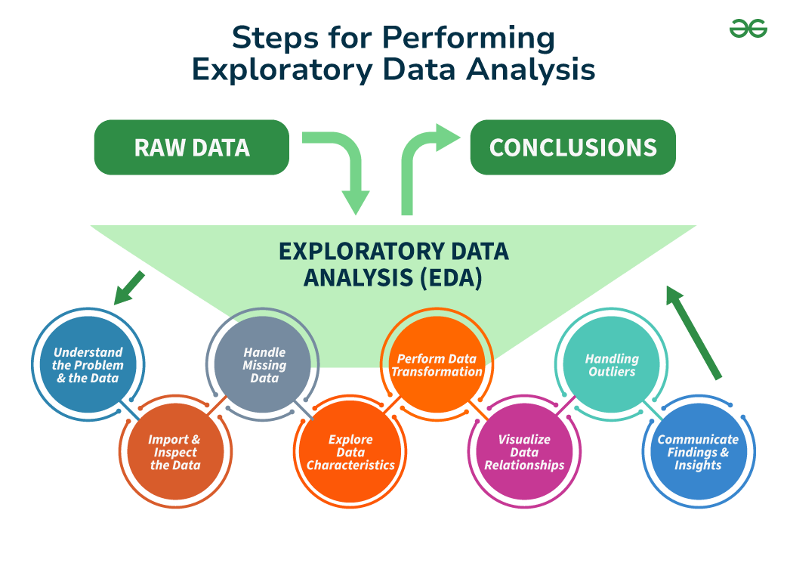
Data exploration continue….

Slide 7
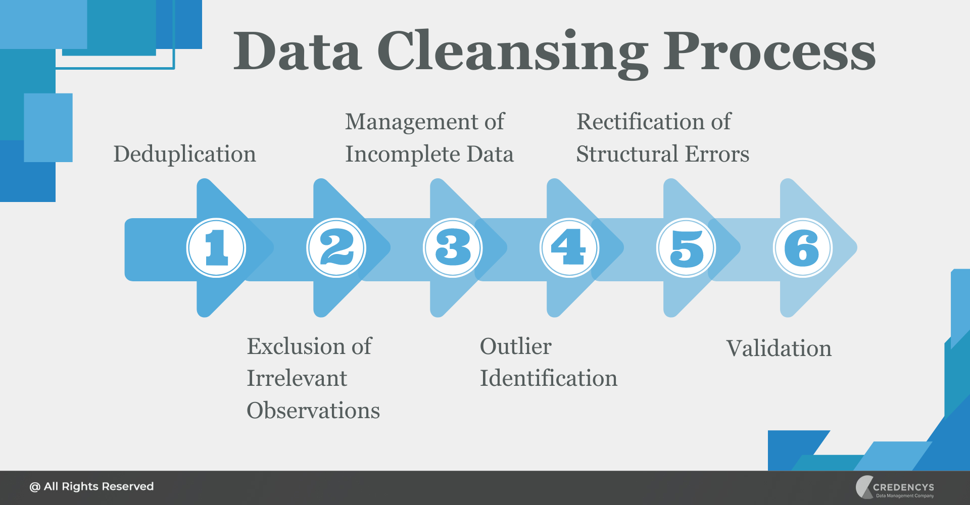
Data Cleaning Process
Data cleaning involved handling missing values, removing duplicates, and correcting data types. The steps taken ensured the dataset was ready for analysis.

Slide 8
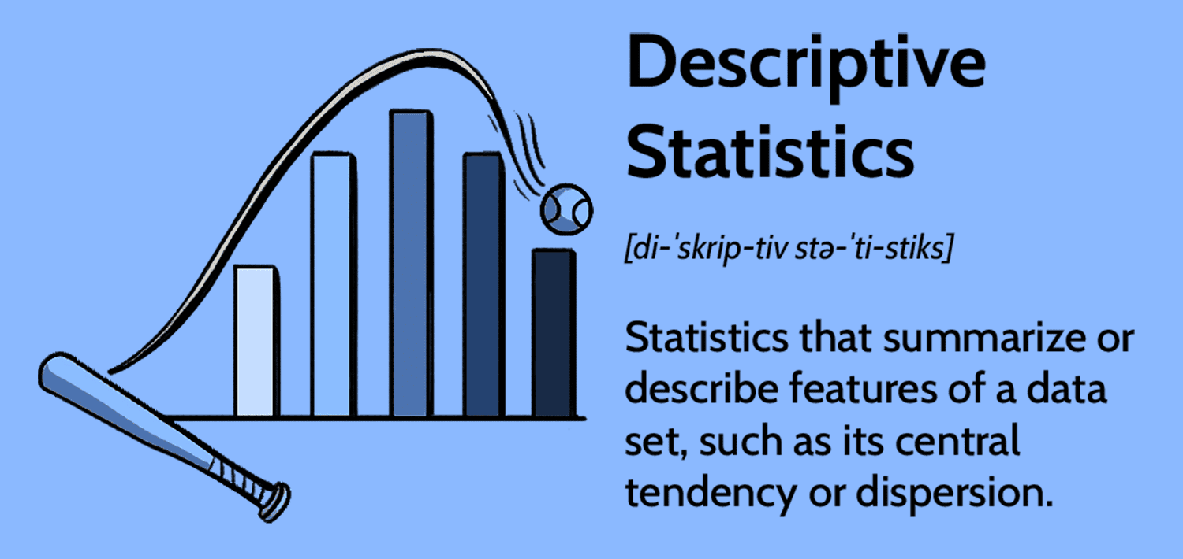
Descriptive Statistics
Key descriptive statistics, such as mean, median, and standard deviation, were calculated to understand the distribution of the dataset. The distribution of property prices and lot areas are highlighted below.

Slide 9
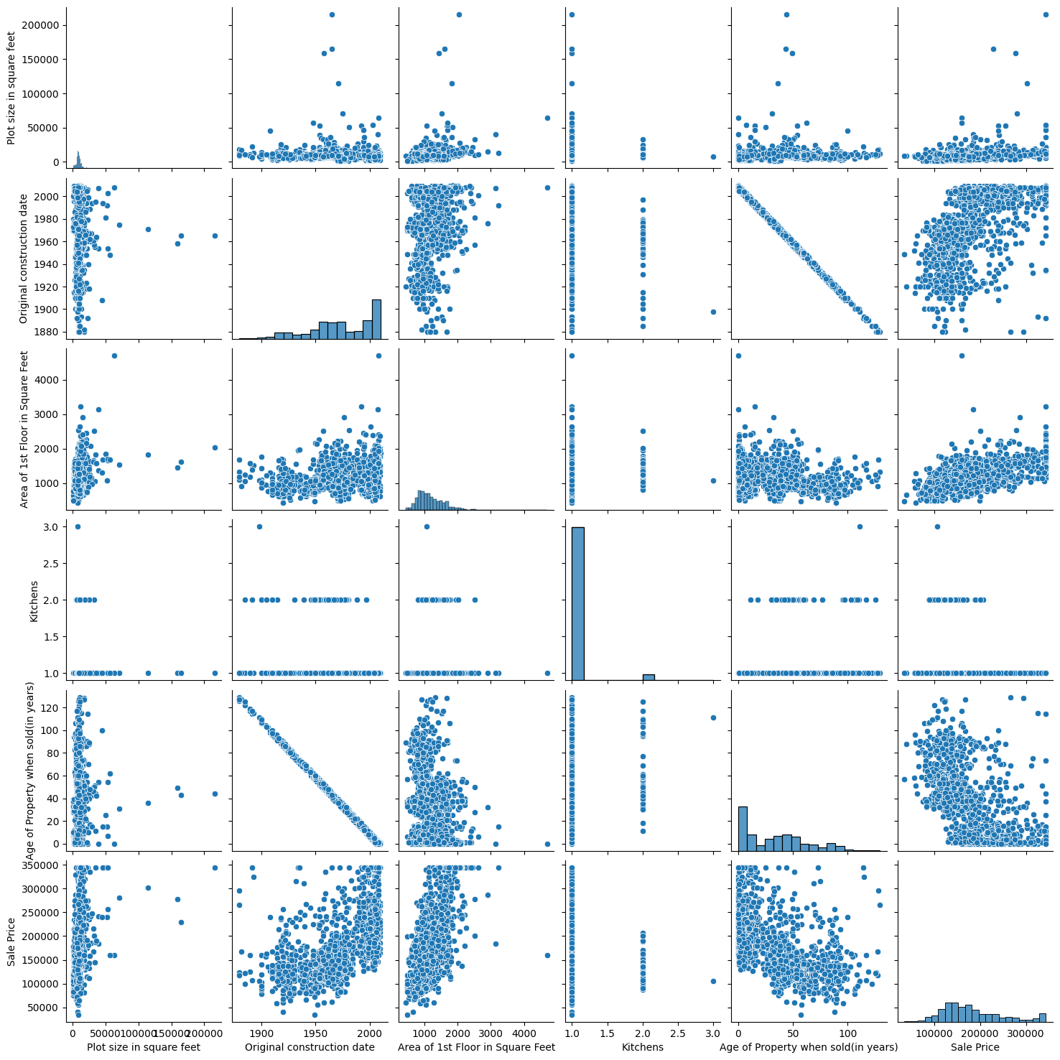
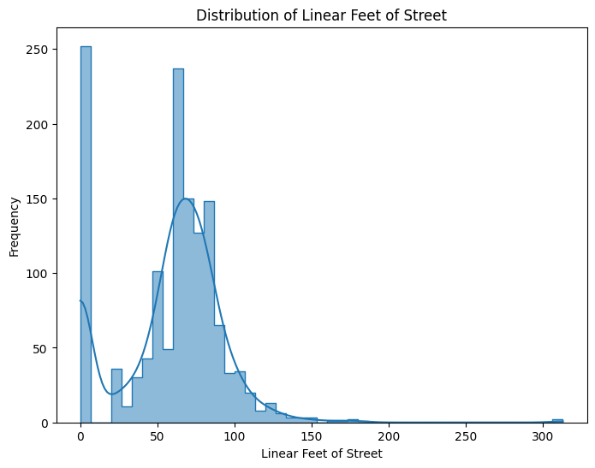
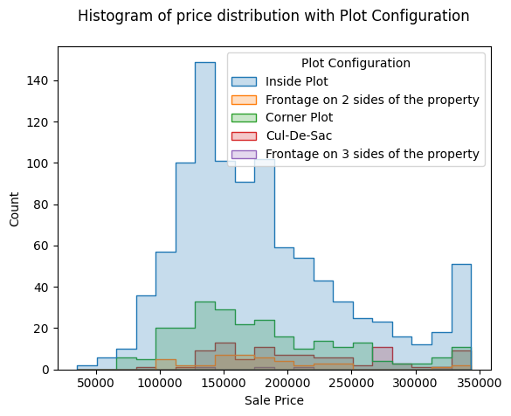
Data Visualization
Visualizations such as scatter plots, histograms, and box plots were used to identify trends and patterns in the dataset. These visualizations provide a deeper understanding of the data.

Slide 10
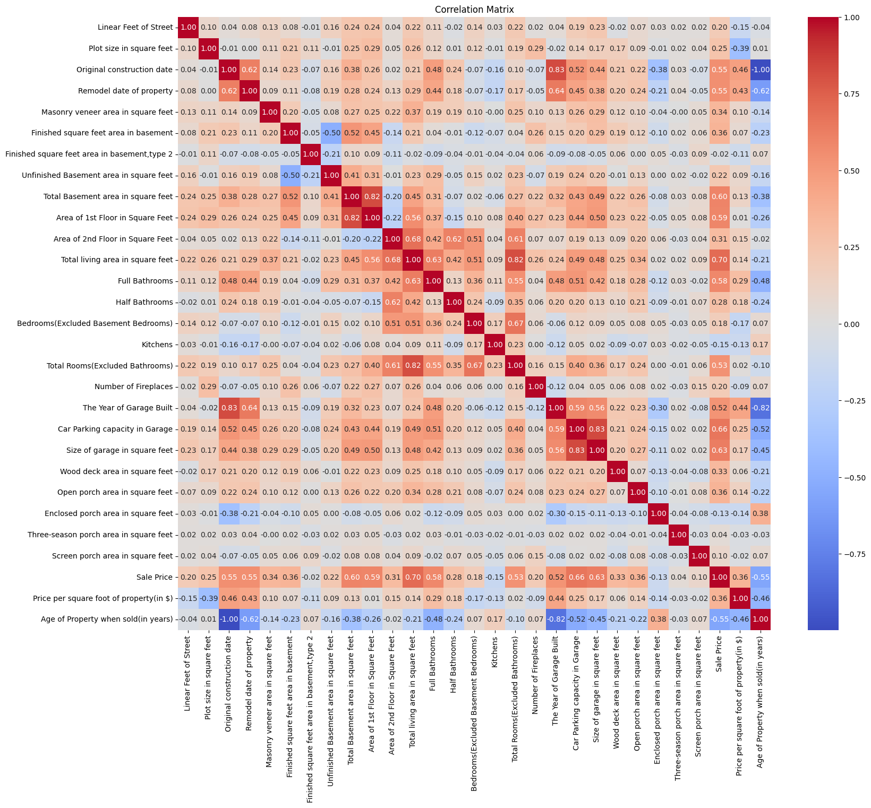
Correlation Analysis
Correlation analysis was conducted to explore the relationships between variables, such as property size and price. A correlation matrix was generated to visualize these relationships.

Slide 11
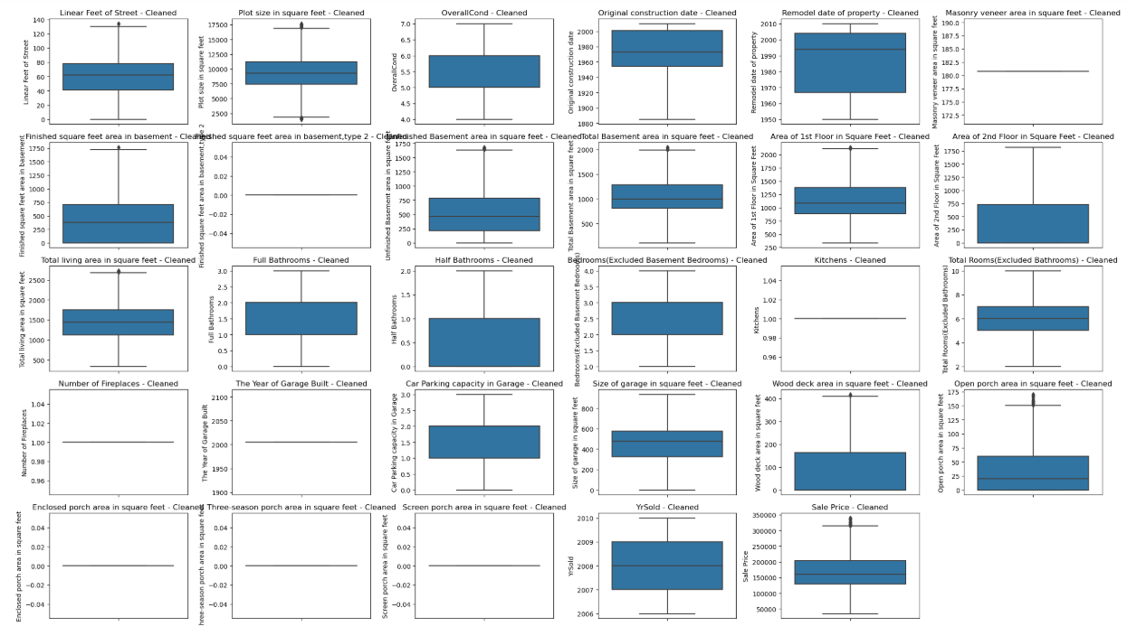
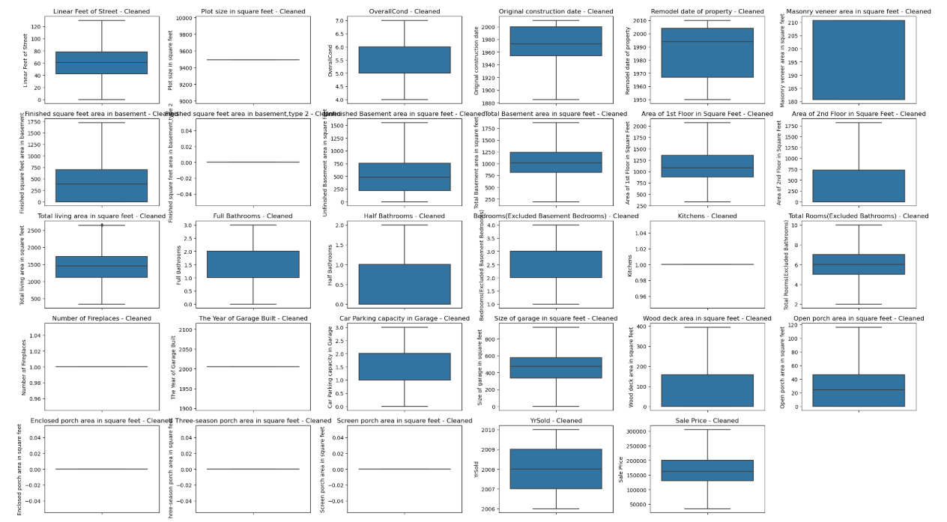
Identifying Outliers
Handle outliers with IQR method
def iqr_technique(DFcolumn):
Q1 = np.percentile(DFcolumn, 25)
Q3 = np.percentile(DFcolumn, 75)
IQR = Q3 - Q1
lower_range = Q1 - (1.5 * IQR)
upper_range = Q3 + (1.5 * IQR)
return lower_range, upper_range

Slide 12
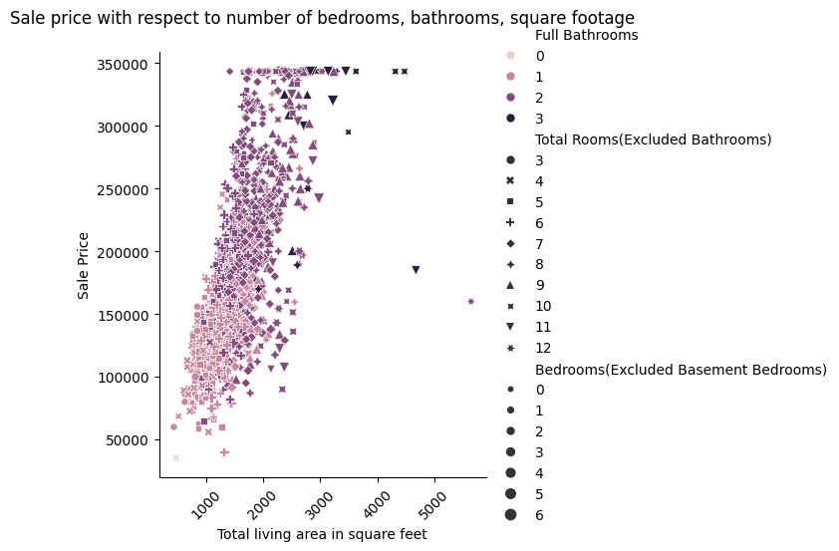
Feature Engineering
New features were engineered from existing variables to better capture trends in the data. For example, combining 'bedrooms' and 'bathrooms' into a single 'rooms' feature.
Observations:
1. The total living area ranges from 2000 to 3000 for higher sale prices
2. Total room ranges from 8-11 and Bedroom from 3 to 5 for good sale price

Slide 13
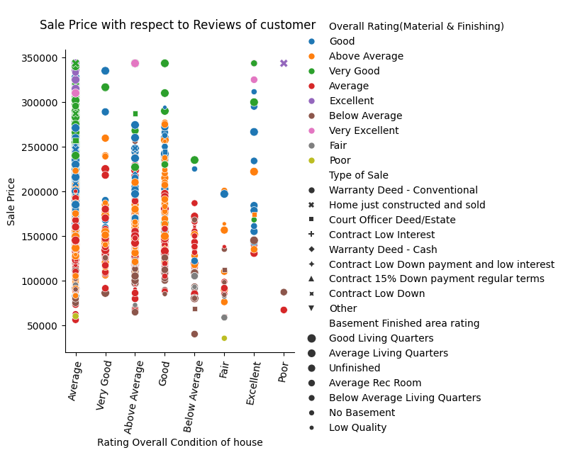
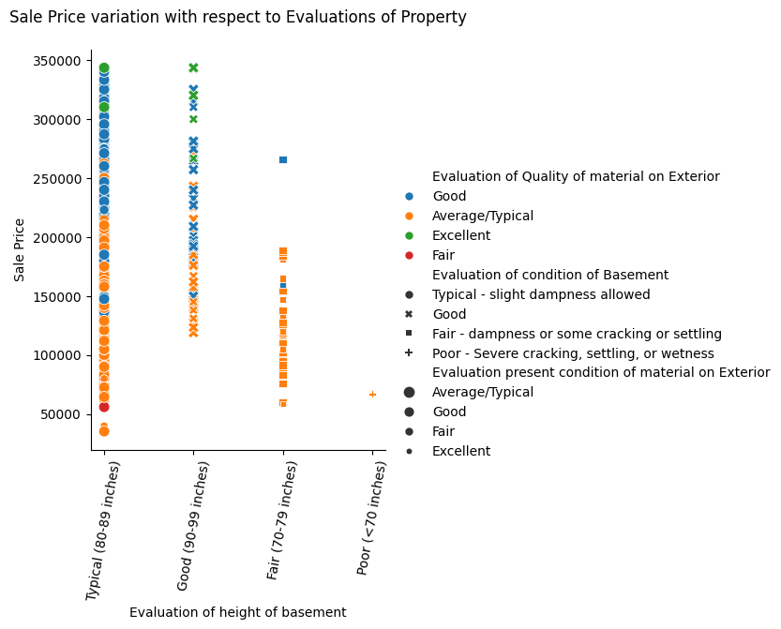
Key Insights
The EDA revealed important trends in property prices, the influence of various features on pricing, and outliers that affect the analysis. These insights can be used to make informed decisions in the real estate market.

Slide 14
Conclusion
Exploratory Data Analysis (EDA) plays a crucial role in real estate pricing analysis, helping stakeholders make data-driven decisions. The insights gained from this analysis provide a solid foundation for further modeling and prediction.
Conclusion: Property Price Analysis
The prices of properties tend to be higher when the following conditions are met:
Property Age: Houses that are constructed and sold within 20 years of their construction.
Room and Property Layout: Properties featuring 7-10 total rooms, including 1 kitchen, 1-2 full bathrooms, and with a property shape that is regular or slightly irregular.
Room and Property Layout: Properties featuring 7-10 total rooms, including 1 kitchen, 1-2 full bathrooms, and with a property shape that is regular or slightly irregular.
Living and Garage Space: Homes with a living area of 1,500-2,500 square feet, and a garage size ranging from 500-800 square feet.
Garage Characteristics: Properties with an attached garage capable of accommodating 2-3 cars, with the garage having average quality and condition.

Slide 15
Thank you

